Slide 1
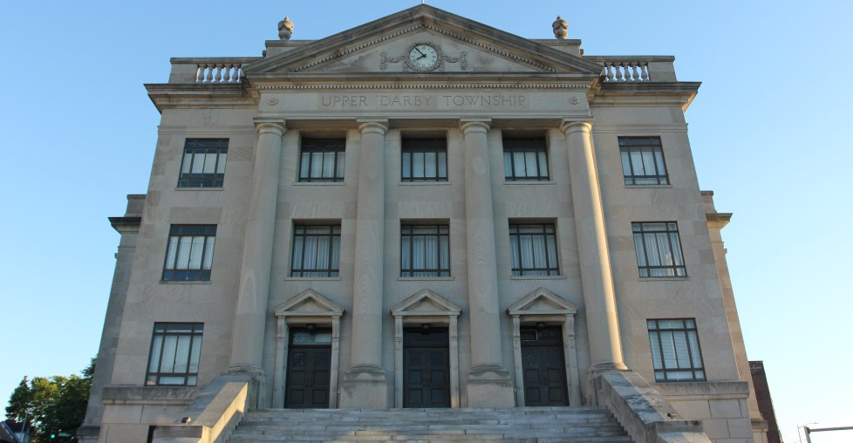

‘The World in One Place’
Upper Darby Township
FY2025 Proposed Amended Budget Informational Presentation

Slide 2
Agenda
Key Clarifications
Department Highlights – Township Goals & Targets for Accomplishment
Changes to the Budget from the FY2025 Original Approved Budget
Fund Balance and the necessity for an Earned Income Tax
‘The World in One Place’

Slide 3
Key Clarifications
No services are being cut in the 2025 Proposed Amended Budget. It is functionally the same budget, but with a different funding source.
An increase in pay for all Township employees still stands, no employee is receiving a reduction in pay.
The 2025 Proposed Amended Budget still ensures strategic resource allocation to improve and maintain public service.
‘The World in One Place’

Slide 4
Department Highlights
The 2025 Proposed Amended Budget sets the following targets for accomplishment and affords the Township’s departments the following service improvements:
Admin Services: Upgraded tech equipment agreements and increased cybersecurity.
Finance: Allows for the hiring of a Finance Director.
Human Resources: Streamlines the management of salaries and benefits.
Community & Economic Development: Creates a position for a new Planning and Zoning Technician and updates data analysis software to attract investment and produce data for grant applications.
Licenses & Inspections: Creates a position for a new Right-of-Way Inspector and allows for the implementation of a modern permitting and inspection system
‘The World in One Place’

Slide 5
Department Highlights, Continued
6. Fire: Streamlines record management allows for a more robust Technical Rescue Program and integration with L&I.
7. Police: Allows for the hiring of five new Police Officers and improves the real-time crime center and Officer recruitment, retention and training.
8. Parking Enforcement: Ensures consistent parking enforcement through increased staffing, the implementation of body cameras, in-service training, and adherence to best practices through accreditation.
9. Public Works: Creates the Assistant Public Works Director and Township Engineer positions
10. Recreation (LS): Maintains park amenities across the Township and builds inventory and supplies
11. Senior Services (LS): Additional services and supplies to improve the well-being of seniors and grow the homebound meals program.
12. Historic Sites (LS): Funds to support volunteers and programming.
‘The World in One Place’

Slide 6
Changes to 2025 General Fund Revenue – Original Approved Budget
Original Approved Revenue Budget: $101,671,878
Removed Earned Income Tax: ($ 15,175,900)
101-31040-480-10000
Added Fund Balance: $ 10,565,093
101-39999-499-10000
Added ARPA interest earned: $ 702,000
101-39215-480-10000
Total 2025 General Fund Revenue
Proposed Amended Budget: $ 97,763,071
‘The World in One Place’

Slide 7
Changes to 2025 General Fund Expense – Original Approved Budget
Original Approved Expense Budget: $101,671,878
Removed Keystone commission: ($ 220,051)
101-44317-480-10000
Removed Operational Reserve: ($ 2,188,756)
101-47700-480-10000
Reduced Capital Reserve: ($ 1,500,000)
101-48438-480-10000
Total 2025 General Fund Expense
Proposed Amended Budget: $ 97,763,071
‘The World in One Place’

Slide 8
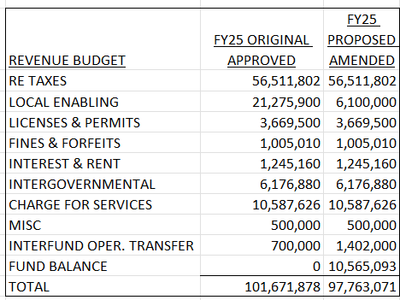
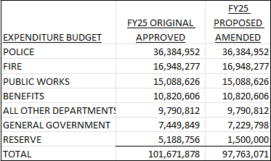
Fy25 General Fund Revenue/Expenditure - Proposed Amended Budget Compared to Original Approved Budget
‘The World in One Place’

Slide 9
Highway Liquid Fuels, Sewer and Sinking Funds – FY2025 Proposed Amended Budget
The Highway Liquid Fuels, Sewer and Sinking Funds Proposed Amended Budgets remain the same as the Original Approved Budgets.
Highway Liquid Fuels Fund is a balanced budget of $2,965,902
Sewer Fund is a balanced budget of $12,908,055
Sinking Fund is a balanced budget of $2,009,360
‘The World in One Place’

Slide 10
The Importance of an Adequate Fund Balance
The Government Finance Officers Association (GFOA) emphasizes the critical role of fund balance in maintaining a government’s financial health and operational stability. Key reasons for its importance include:
Risk Mitigation: Adequate fund balance levels help governments manage current and future risks, such as revenue shortfalls and unexpected expenditures, ensuring the continuity of services without sudden tax increases or service reductions. Government Finance Officers Association
Revenue Stability: Maintaining sufficient fund balance contributes to stable tax rates, as it provides a financial cushion that can absorb economic fluctuations and unforeseen financial challenges. Government Finance Officers Association
Creditworthiness: A healthy fund balance positively influences a government's bond ratings, potentially reducing borrowing costs and enhancing access to credit markets. Government Finance Officers Association
Financial Flexibility: Fund balance offers the flexibility to respond to emergencies, natural disasters, or other unexpected events without compromising financial stability. Government Finance Officers Association
Long-Term Planning: A well-maintained fund balance supports strategic financial planning and sustainability, allowing governments to invest in capital projects and other long-term initiatives. Government Finance Officers Association
‘The World in One Place’

Slide 11
Fund Balance FY23 with Estimates for FY24 and FY25
Fiscal Year End: Fund Balance: Source:
December 31, 2021 $158,531 Per Audit
December 31, 2022 $4,881,170 Per Audit
December 31, 2023 $10,436,502 Per Audit
December 31, 2024 $14,312,877 Per Finance Dept. Projection
December 31, 2025 $10,443,034 Per Finance Dept. Projection (with mid-year EIT implementation)
December 31, 2025 $ 3,747,784 Per Finance Dept. Projection(without EIT)
‘The World in One Place’
Notes:
Add ‘21 and ‘22 here

Slide 12
Upper Darby Township’s Fund Balance
‘The World in One Place’
Notes:
Add separate ‘25 projection considering implementation of EIT

Slide 13
Why Upper Darby Needs an Earned Income Tax
Increasing obligations for union wages, pension contributions, and health insurance
Fund balance is $16 Million below recommended levels without EIT
  With the implementation of a mid-year EIT, $10 Million below recommended levels
Financial stability and well being
‘The World in One Place’

Slide 14
Earned Income Tax
Alternate Revenue Stream - remove dependency on Property Taxes.
Reduces burden for retired homeowners.
22 of the 49 municipalities in Delaware County have an EIT. 97% of all municipalities in PA have an EIT. All municipalities the size of Upper Darby have implemented EIT. In 2025, Aldan borough, Upper Providence township and Ridley Park borough have implemented an EIT.
Financial stability for the Township.
Fund capital projects in the future.
‘The World in One Place’
Notes:
What % of cities/municipalities in all of PA have an EIT?

Slide 15
Earned Income Tax
Keeps pace with contractual obligations – 2026 expected contractual increase is will exceed $2.6M
Summary | FY2025 Total | Annual Increase | FY2026
Police | $14,885,119 | 3.00% | $446,554
Fire | $6,865,783 | 3.00% | $205,973
TWU | $8,260,274 | 3.50% | $289,110
OPEIU | $3,758,109 | 3.75% | $140,929
Non-Bargaining | $4,854,686 | 3.00% | $145,640
Health Insurance | $10,831,116 | 8.00% | $866,489
Retiree Health Insurance | $6,512,139 | 8.00% | $520,971
Pension Increase |  |  | $55,000
 | $55,967,226 |  | $2,670,666
Note 1: Assumes an 8% increase for health insurance
Note 2: Pension increase is for hiring of new officers
Note 3: Does not include any increases in ER Taxes
‘The World in One Place’
Notes:
OPEIU: 3.75%
Non-bargaining: Add

Slide 16
Conclusion
The fiscal sustainability of the Township depends on the establishment of a proper Fund Balance and the implementation of an Earned Income Tax.
Taxes alone will not fund:
  Annually increasing operating costs (salary increases, healthcare, pension benefits, supplies and equipment, etc.)
  Desired Capital Projects (Community Center, Naylor’s Run & Observatory Hill restoration)
  Ongoing capital improvements to sewer systems, roads, buildings, equipment, vehicles, etc.
‘The World in One Place’

Slide 17
‘The World in One Place’
THANK YOU

